Slide 1



Grand Plaza Hotel Management System
Welcome to an overview of our hotel management solution.

Slide 2
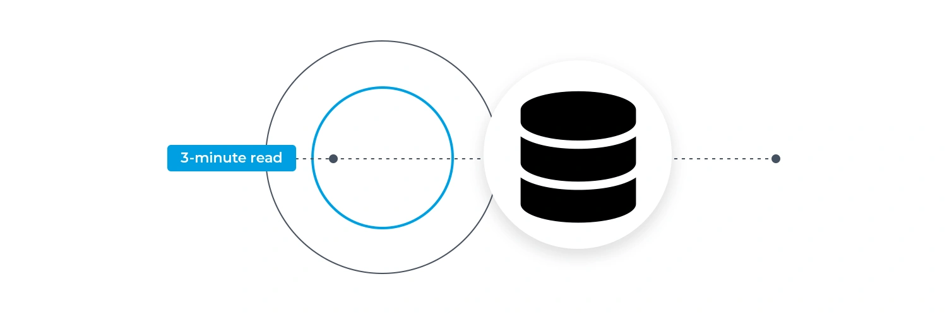
Introduction to the System
Database Schema Overview
A full-stack system with:
Frontend : (HTML, CSS, JS)
Backend (PHP)
Database (MySQL)
Real time data synchronization
Scalable and secure architecture
Main Database Tables:
Rooms – Room details, types, status
Guests – Guest profiles, contact info
Bookings – Reservation records
Invoices – Billing and payments
User – Admin and employee access
Visual: ER Diagram of the Database

Slide 3

Dashboard: Daily Overview with Live Data
15
84%
2
1
Total Rooms
Occupancy
Check-ins Today
Check-outs Today
(Pulled from Rooms table)
Calculated from Bookings table
+1 yesterday (Filtered by date)
-2 yesterday (Filtered by date)

Slide 4
Booking Management (DB Operations)
How It Works in the Database:
INSERT new booking into Bookings table
UPDATE room status in Rooms table
SELECT booking details with guest info using SQL JOIN
#1001
John Smith
Room 102
Dec 6, 2025
Dec 7, 2025
$300.00
Confirmed
#1002
Maria Garcia
Room 202
Dec 6, 2025
Dec 13, 2025
$1050.00
Confirmed
#1005
David Brown
Room 305
Dec 7, 2025
Dec 13, 2025
$900.00
#1007
James Miller
Room 203
Dec 5, 2025
Dec 6, 2025
$110.00
Cancelled

Slide 5
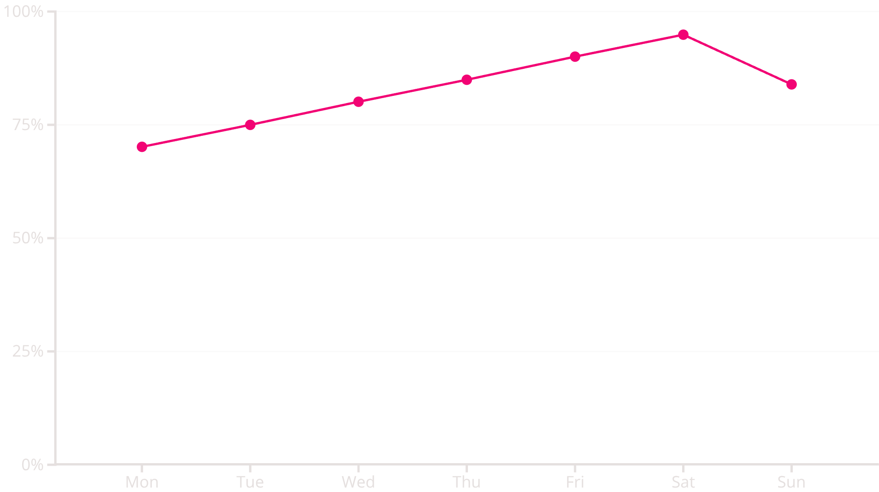
Real time Occupancy & Bookings
Occupancy Rate This Week
Recent Bookings
David Brown - Room 305 (Pending)
Sophia Chen - Room 103 (Confirmed)
John Smith - Room 102 (Confirmed)
Maria Garcia - Room 202 (Confirmed)
Robert Johnson - Room 204 (Confirmed)
View All

Slide 6
Efficient Room Management
Room Management (CRUD Operations)
Database Actions:
Create: Add new room
Read: Fetch room list with status
Update: Change room status (Available/Occupied/Maintenance)
Delete: Remove room from system
101
Deluxe
1
$150
Available
wifi, tv, ac...
102
Standard
1
$100
Occupied
wifi, tv, ac
104
Standard
1
$100
Maintenance
wifi, tv
105
Deluxe
1
$150
Clearing
wifi, tv, ac...
201
Suite
2
$250
Available
wifi, tv, ac...

Slide 7




Secure & Reliable Operations
Our system ensures data integrity and provides essential backup and reset functionalities.
Export All Data
Securely backup your hotel's information.
Import Data
Seamlessly transfer existing records.
Reset All Data
Start fresh when needed.

Slide 8
Here’s Our Website Look Like

Slide 9
Thank You all…

